Slide 1

Introduction to Git

Slide 2

Introduction
  Git is a distributed version control system.
  It helps developers track changes in source code.
  Allows multiple people to work on the same project.
  Created by Linus Torvalds.

Slide 3
WHY GIT IS IMPORTANT
  Tracks complete history of a project.
  Enables teamwork without code conflicts.
  Provides backup and recovery.
  Supports branching and merging.

Slide 4


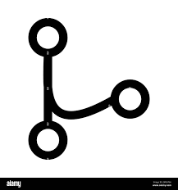

Basic Git Concepts
1. Repository
4. Merge
Project folder tracked by Git.
Combine branches together.
3. Branch
2. Commit
Parallel version of code.
Saved snapshot of changes.

Slide 5
Common Git Commands
1. git init
Initialize repository
2. git status
Check file status
3. git add
Stage changes
4. git commit
Save changes

Slide 6
Conclusion
  Git is essential for modern software development.
  Improves productivity and collaboration.
  Used in academics, startups, and enterprises.

Slide 7
The End

